Slide 1


Faculty Name : Mrs. Sujata Oak
Assistant Professor, RAIT
Dept. Of Information Technology

Slide 2
Agenda
What is Configuration Management?
Why Configuration Management?
Configuration Management Tools

Slide 3
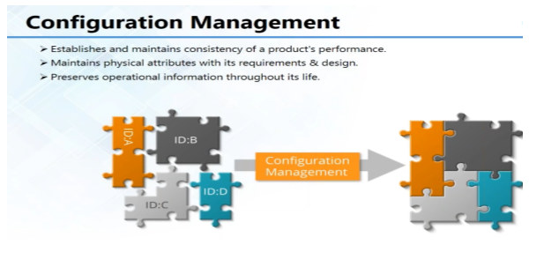
What is Configuration Management?

Slide 4
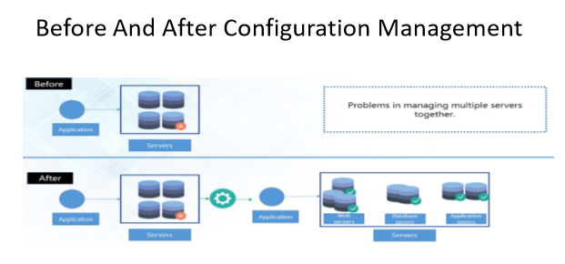
Why Configuration Management?

Slide 5
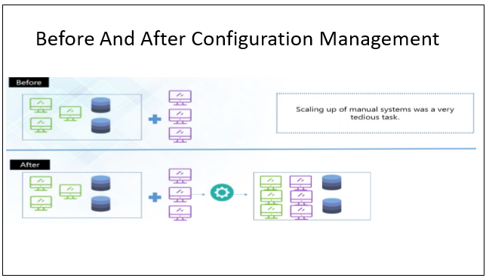
What is Configuration Management?

Slide 6
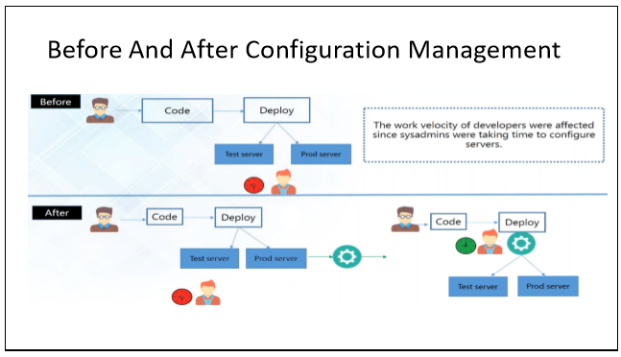
What is Configuration Management?

Slide 7
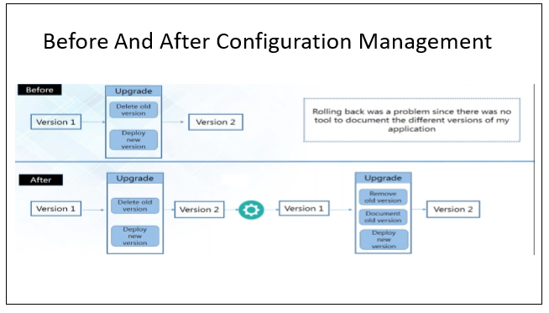
What is Configuration Management?

Slide 8
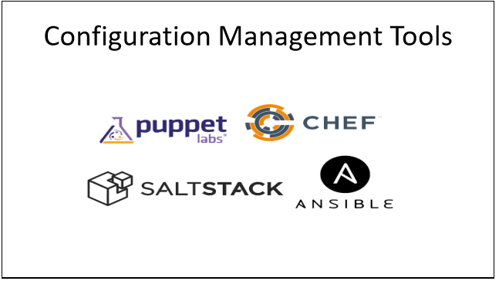
Configuration Management Tools

Slide 9
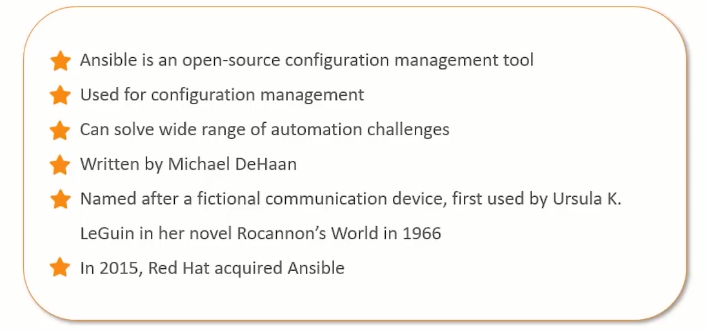
What is Ansible?

Slide 10
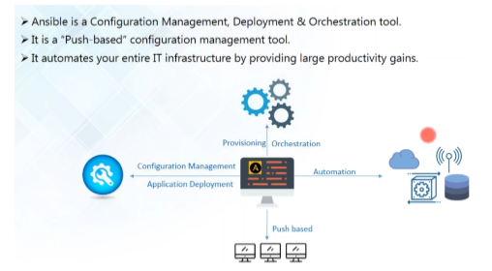
What is Ansible?

Slide 11
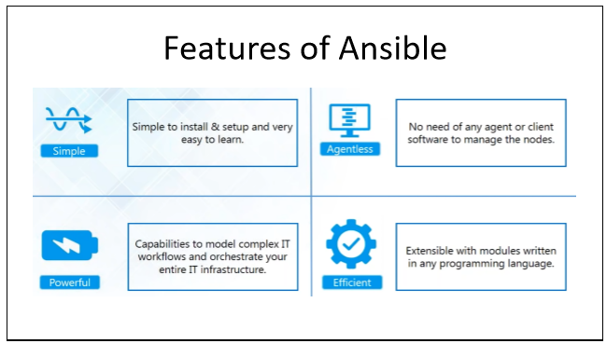
Ansible Features

Slide 12


Slide 13
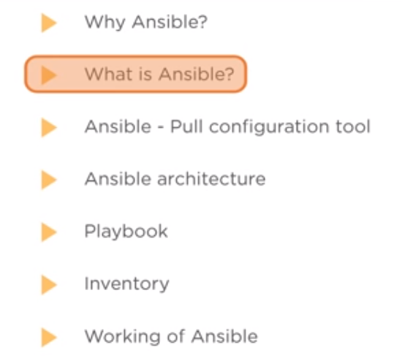
Agenda

Slide 14
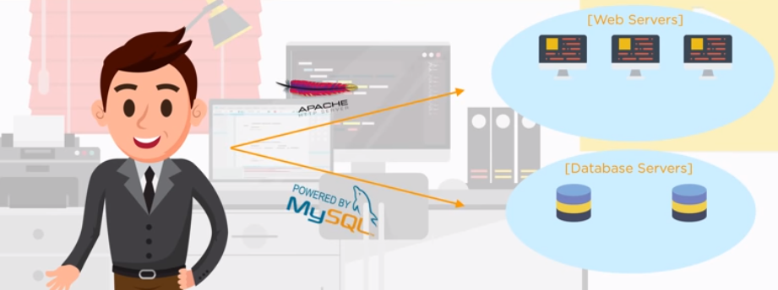
Why Ansible

Slide 15
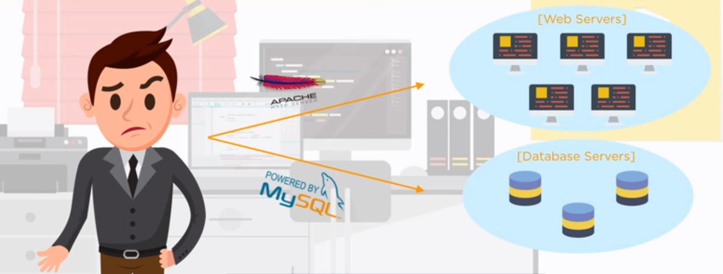
Why Ansible

Slide 16
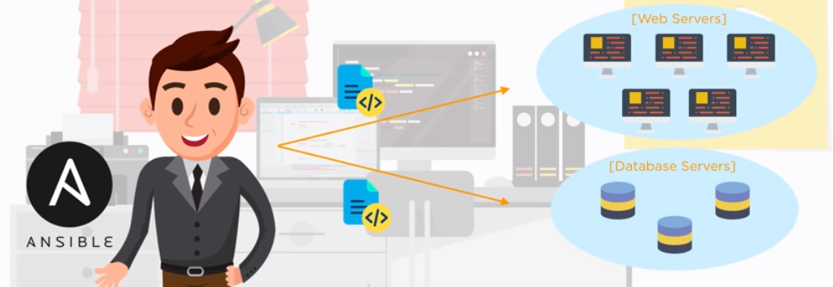
Why Ansible

Slide 17
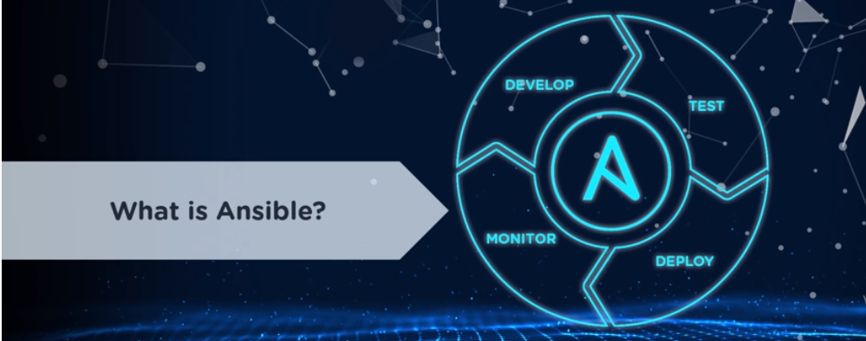

Slide 18
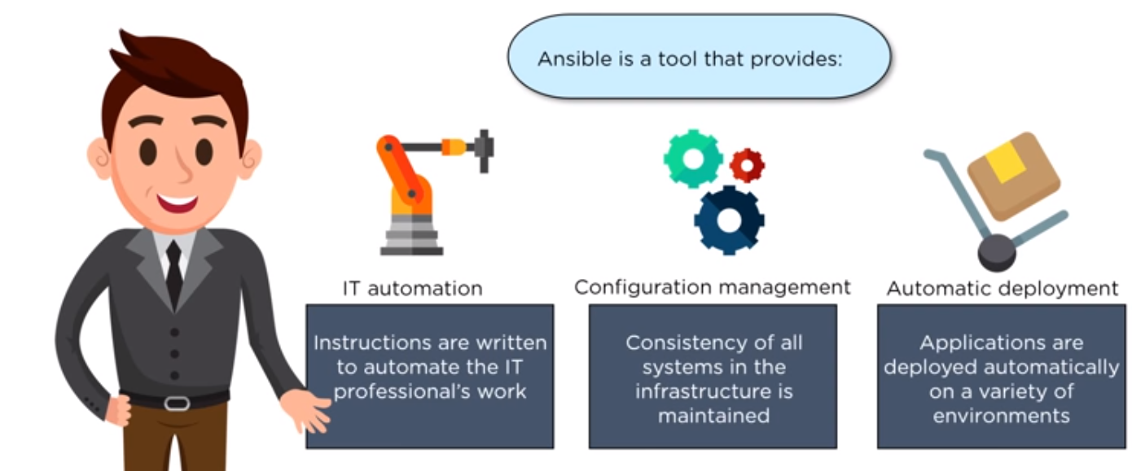
What Is Ansible

Slide 19
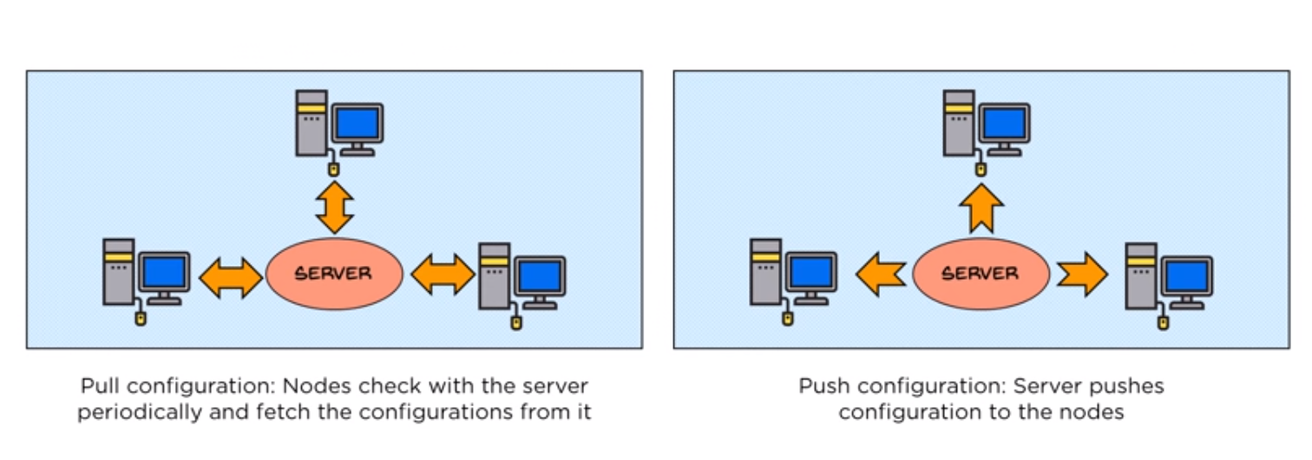
Pull and Push Configuration Tool

Slide 20
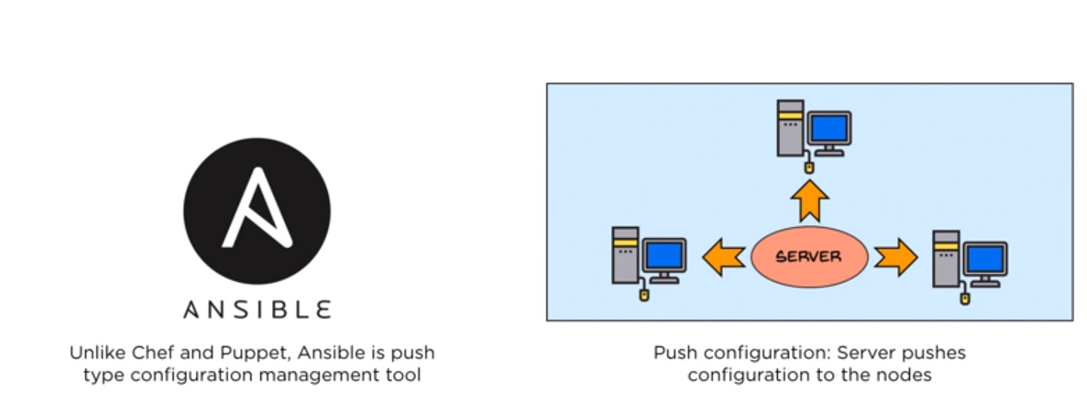
Ansible – A Push Configuration Tool

Slide 21
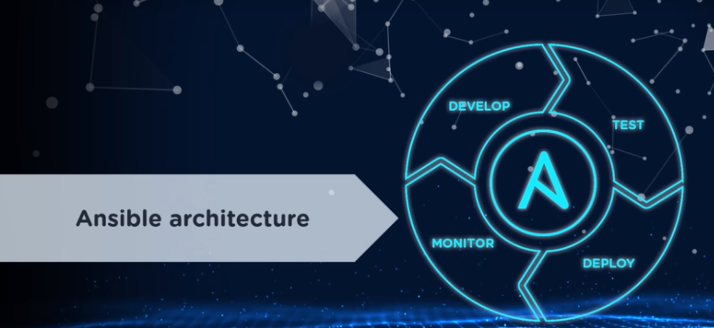

Slide 22
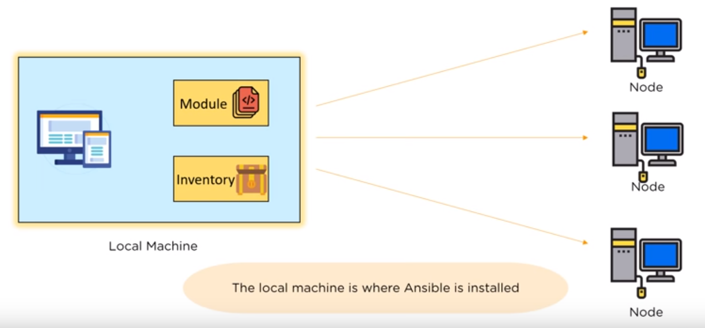
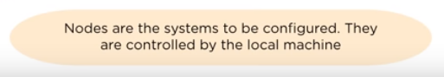
Ansible Architecture

Slide 23
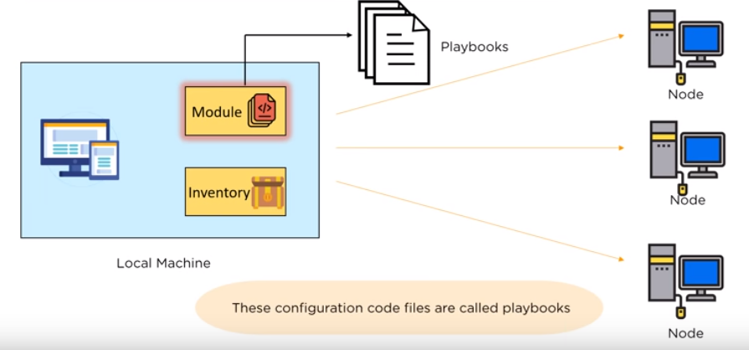
Ansible Architecture

Slide 24
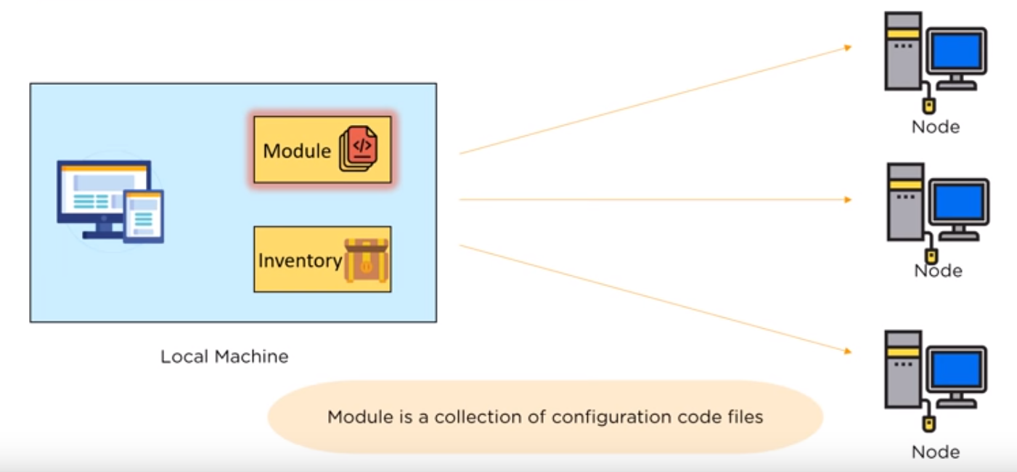
Ansible Architecture

Slide 25
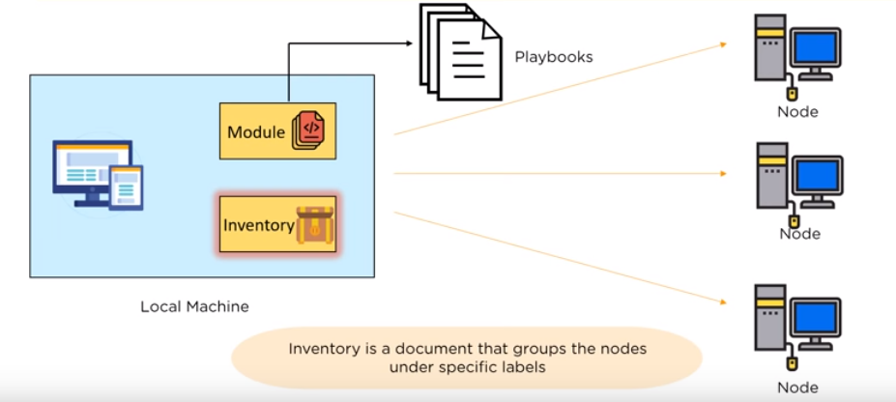
Ansible Architecture

Slide 26
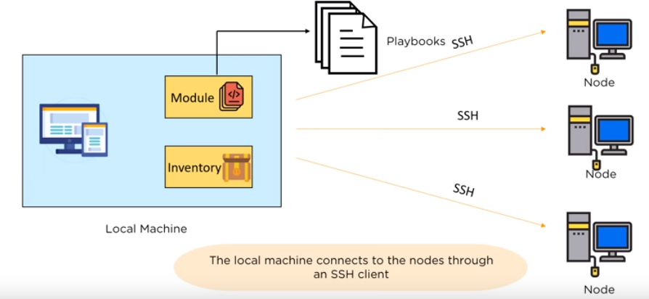
Ansible Architecture

Slide 27
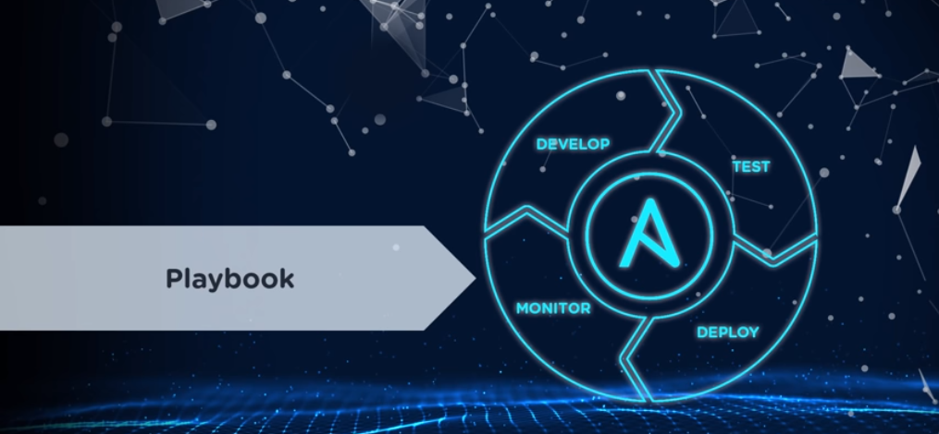

Slide 28
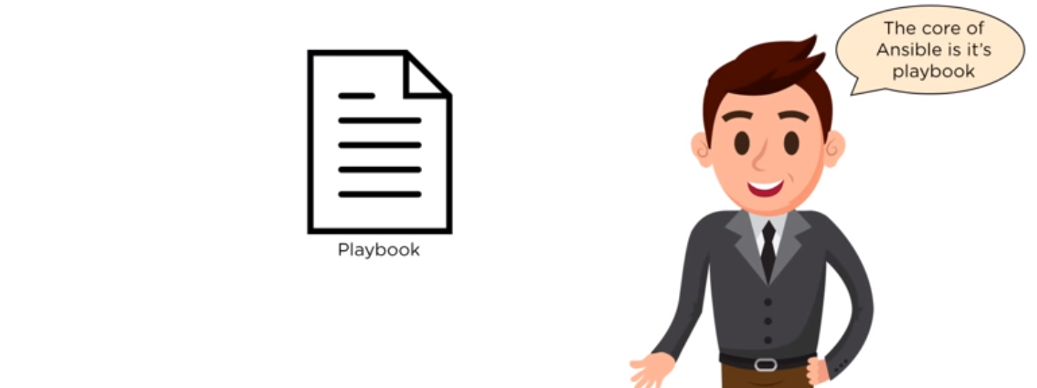
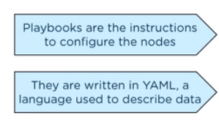
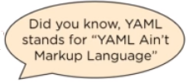
Ansible Playbook

Slide 29
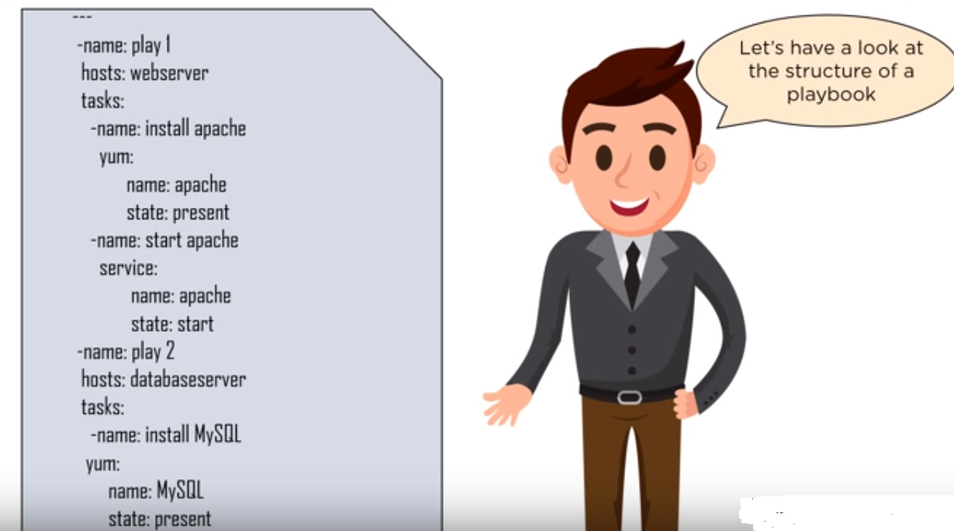
Ansible Playbook

Slide 30
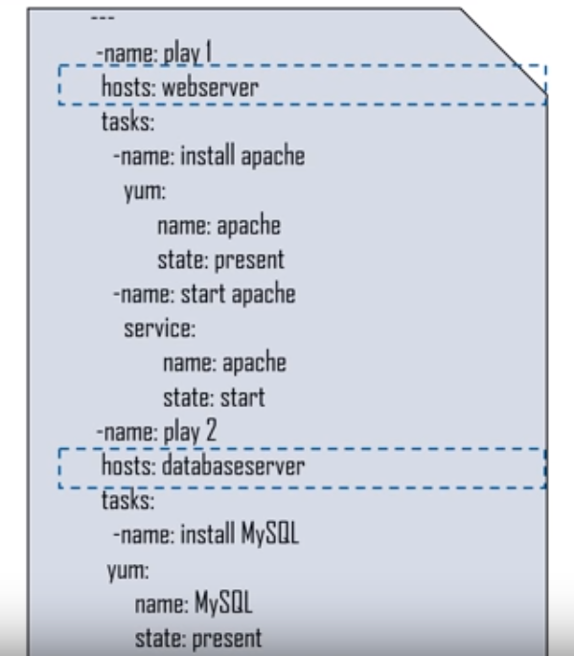
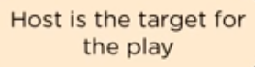
Ansible Playbook

Slide 31
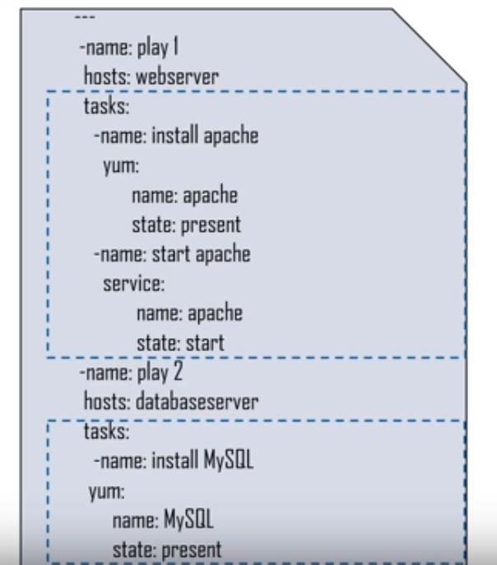
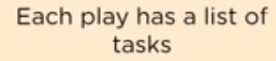
Ansible Playbook

Slide 32
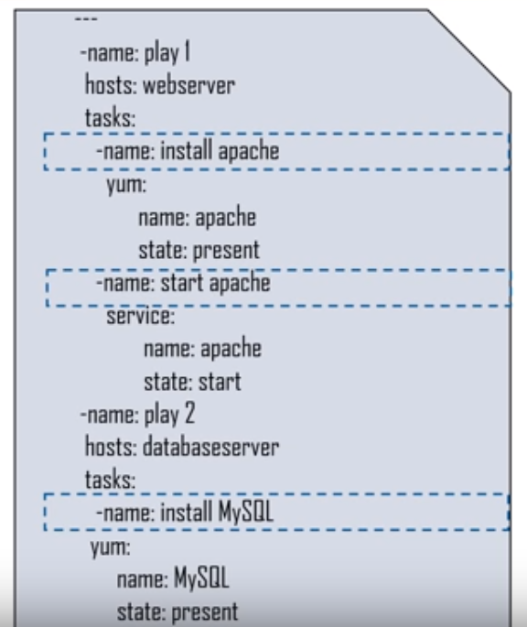
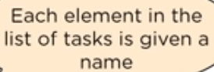
Ansible Playbook

Slide 33
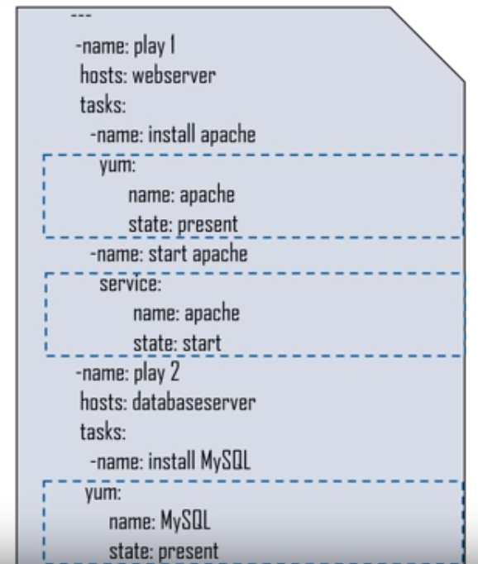
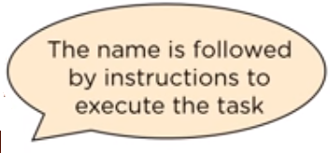
Ansible Playbook

Slide 34
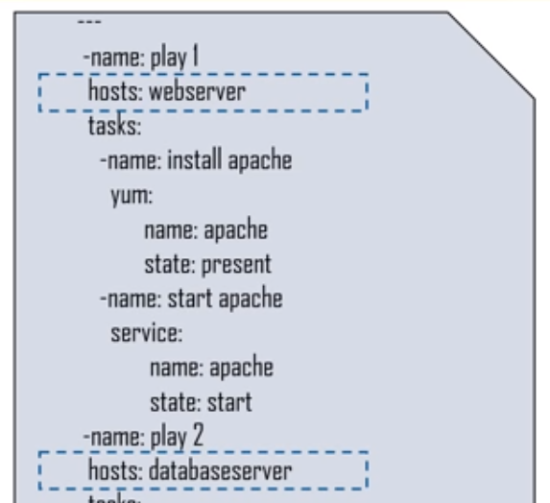
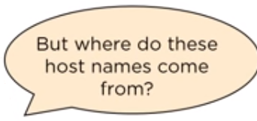
Ansible Playbook

Slide 35
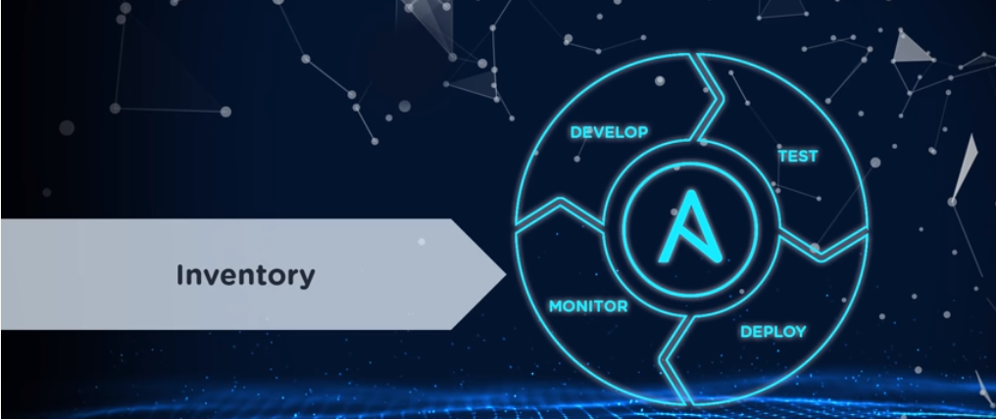

Slide 36

Inventory

Slide 37
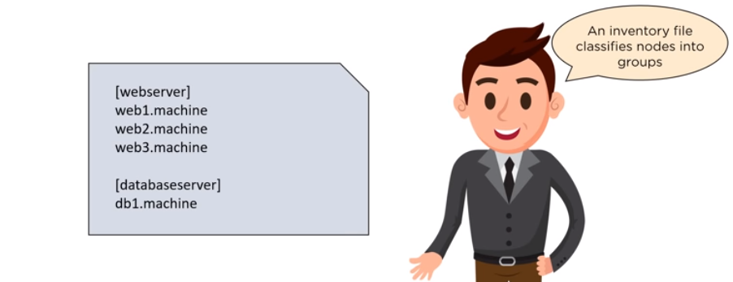
Inventory

Slide 38
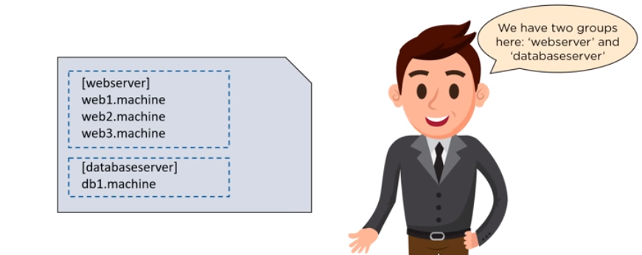
Inventory

Slide 39
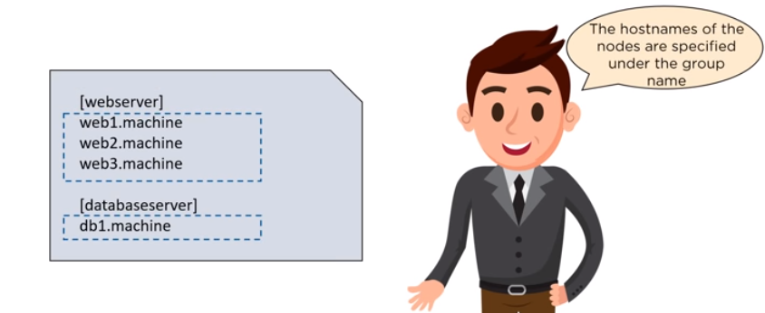
Inventory

Slide 40
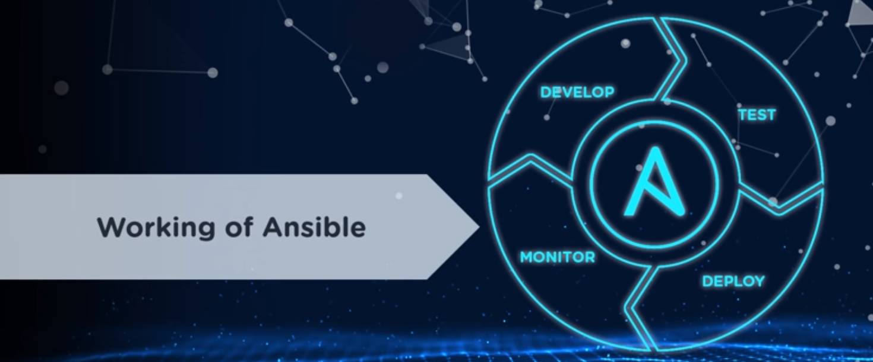

Slide 41
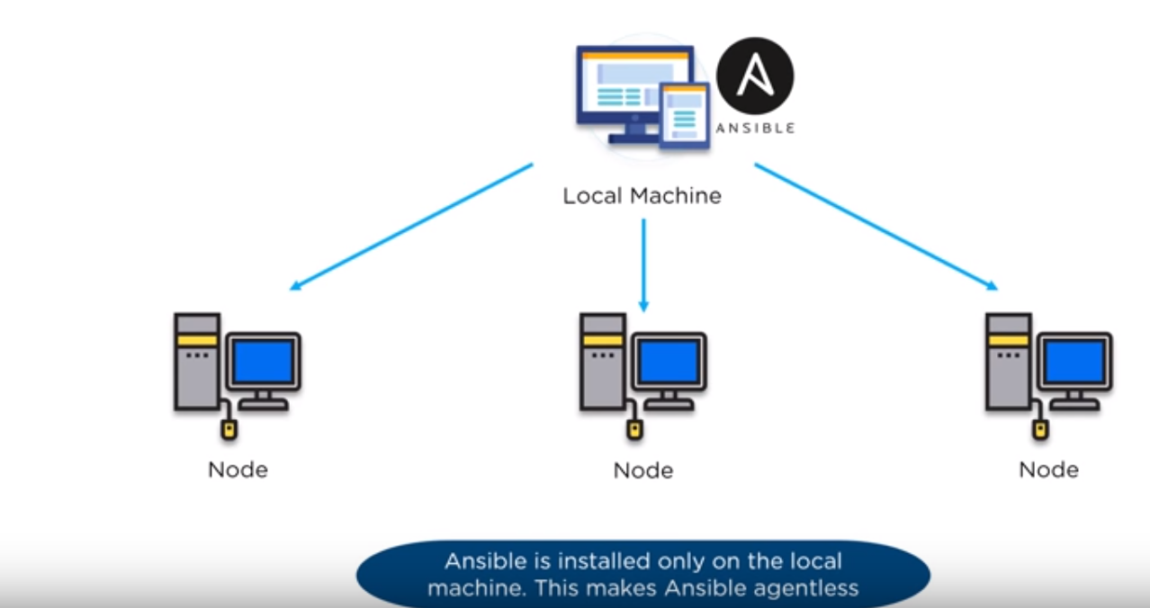
Working of Ansible

Slide 42
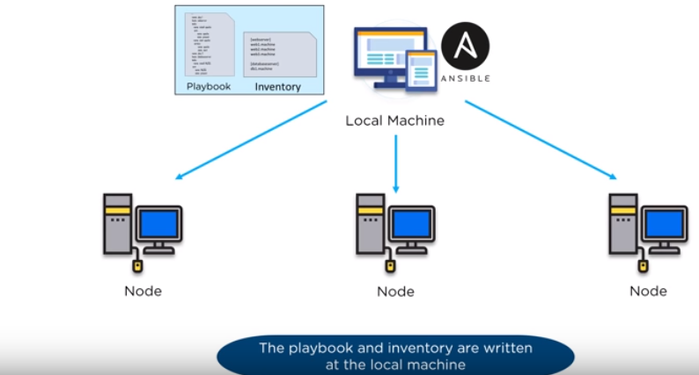
Working of Ansible

Slide 43
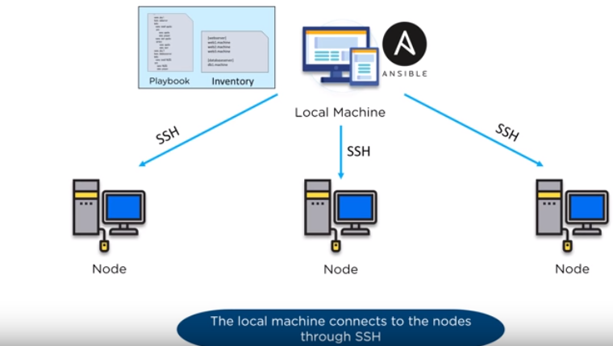
Working of Ansible

Slide 44
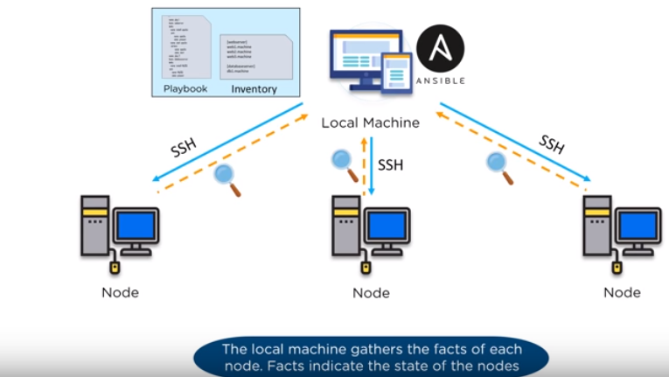
Working of Ansible

Slide 45
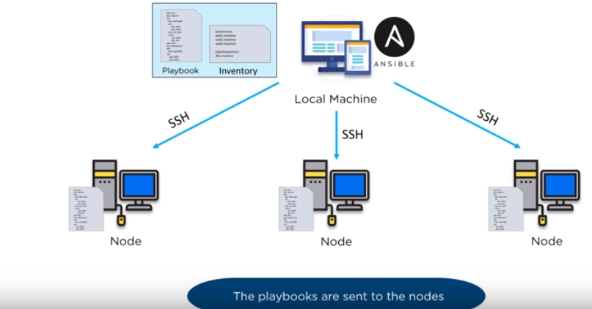
Working of Ansible

Slide 46
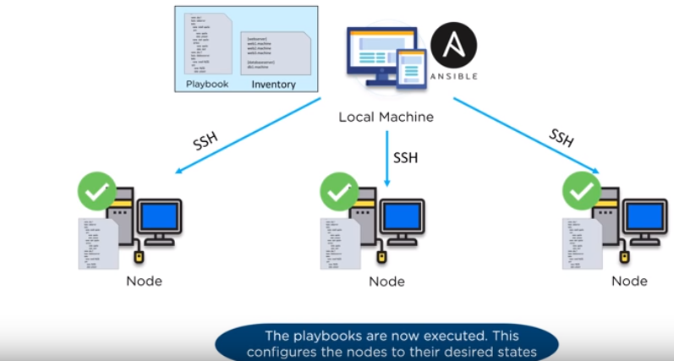
Working of Ansible

Slide 47

Summary

Slide 48


Slide 49



Slide 50



Slide 51



Slide 52


Slide 53


Slide 54


Slide 55


Slide 56




YAML Summary

Slide 57




Slide 58




Slide 59


Slide 60


Slide 61



Slide 62



Slide 63


Slide 64




Slide 65


Slide 66


Slide 67

Scalability

Slide 68

Ease of Setup

Slide 69

Availability

Slide 70

Management

Slide 71

Interoperability

Slide 72

Configuration Language

Slide 73


Popularity: Google Trends [past 5 Years]

Slide 74

Weight-Factor

Slide 75


Conclusion

Slide 76




Slide 77

Thank You

